Slide 1


AGI Welcome you
Fresher’s 2K24

Slide 2

Know Your Management

Slide 3


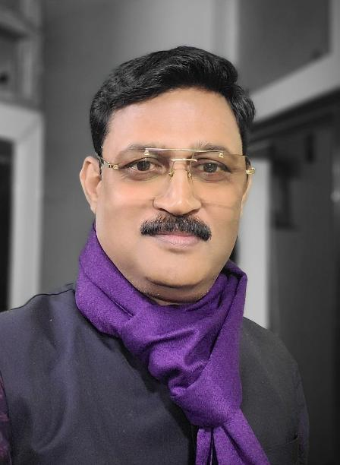
Dr. R.P. Panday
Founder &Chairman
(AGI)

Slide 4

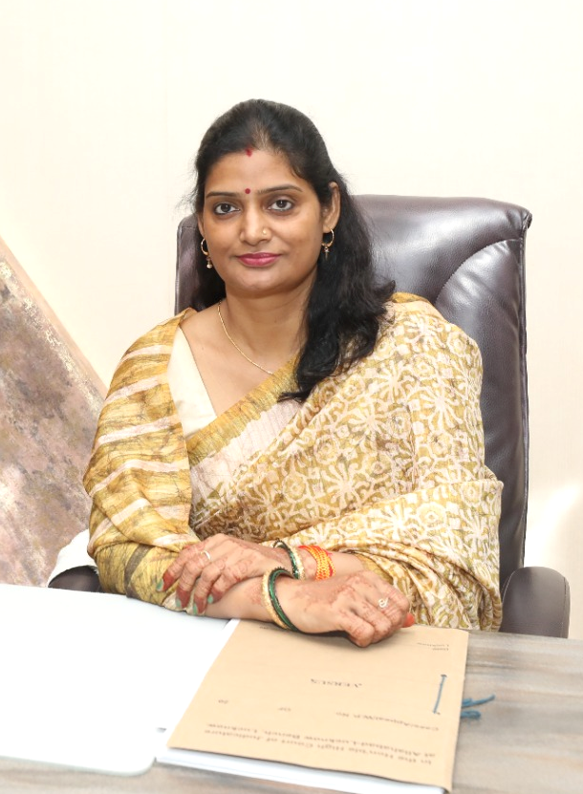
Mrs. Sarita Pandey
Vice Chairperson
(AGI)

Slide 5

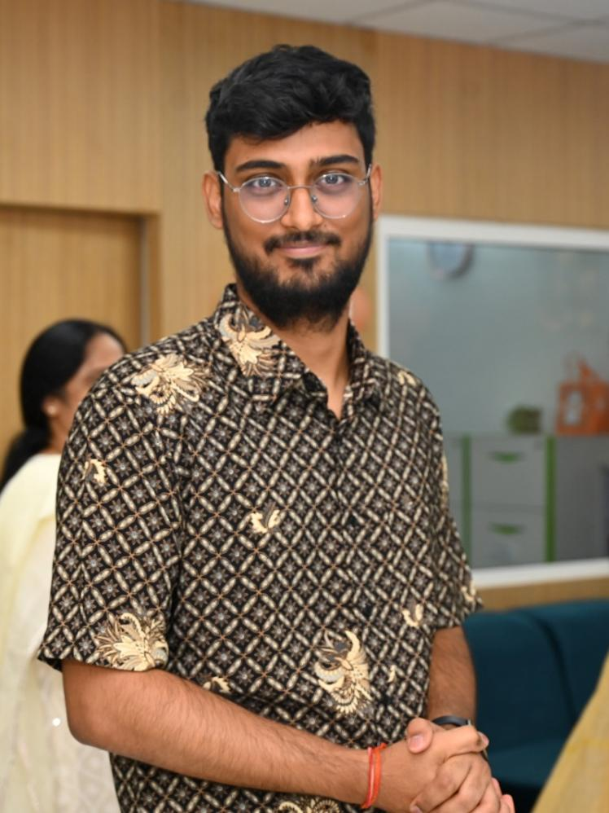
Mr. Naman Pandey
Manager
(AGI)

Slide 6

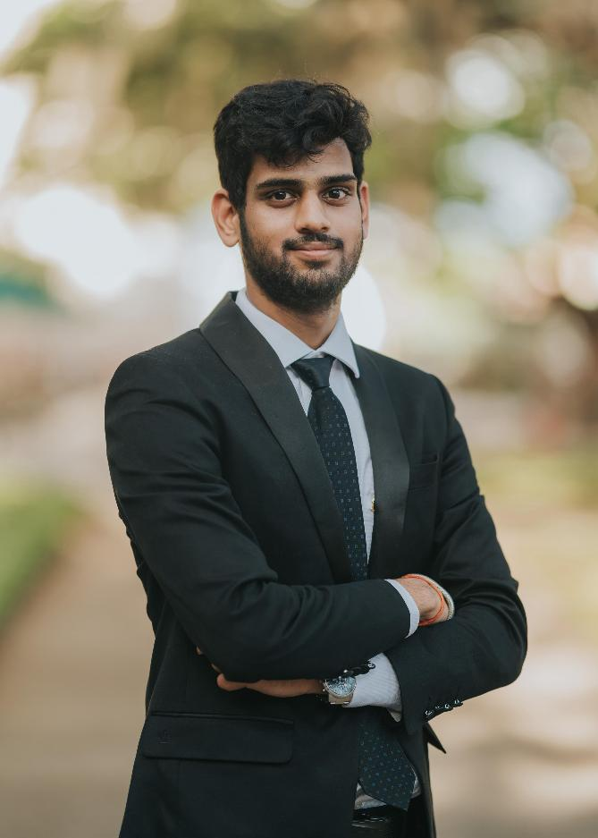
Mr. Mayank Pandey
Deputy Manager
(AGI)

Slide 7

Know Your
Administration

Slide 8

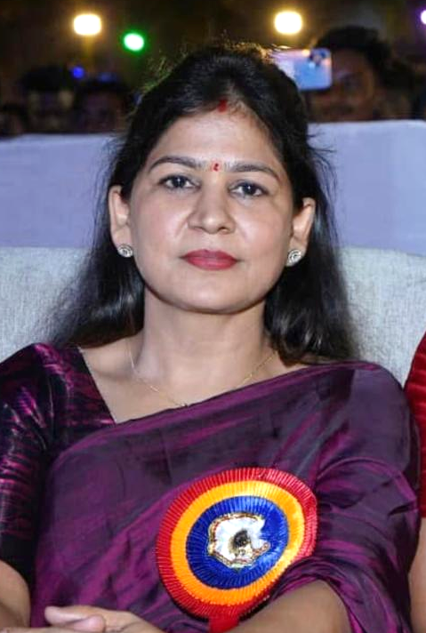
Ms. Sweeti Mishra
Director
(P&E)

Slide 9

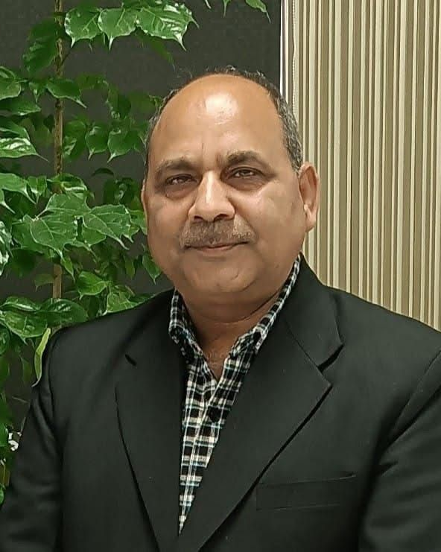
Mr. Jitendra Mishra
Manager
(Admin)

Slide 10

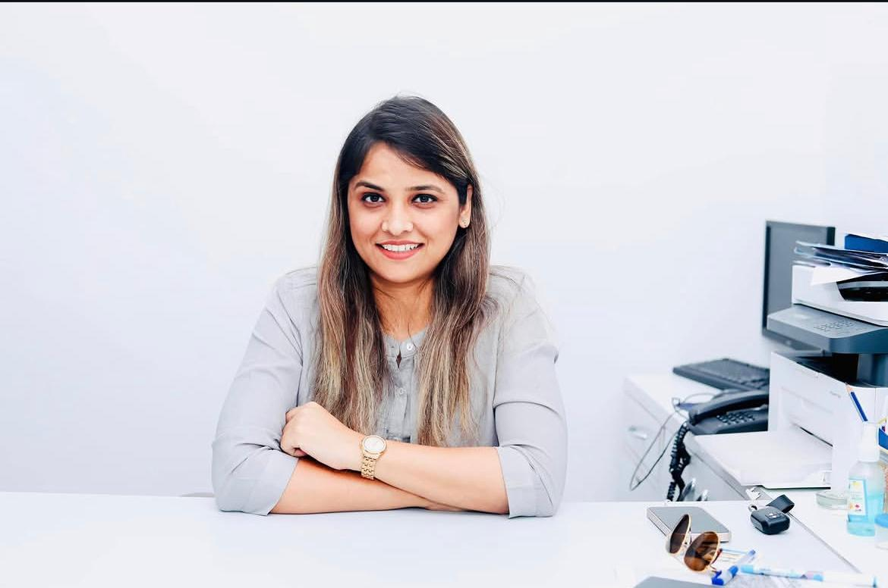
Ms. Anjali Pandey
HR (AGI)

Slide 11

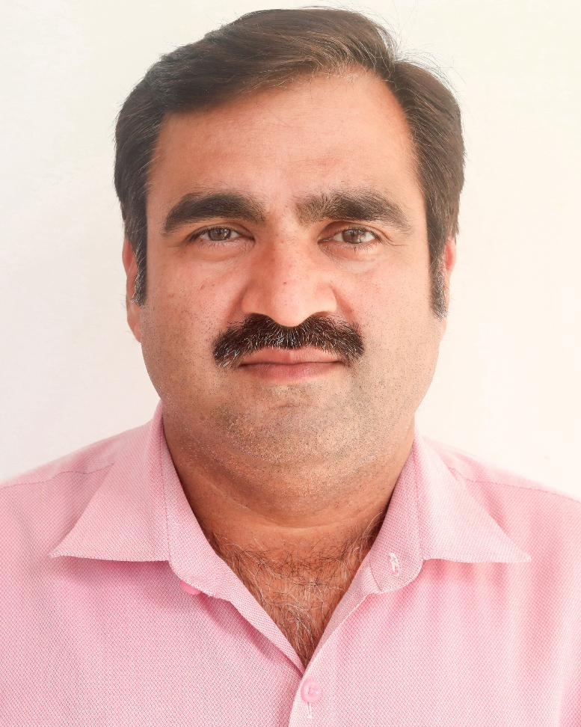
Mr. Karunesh Tiwari
Registrar
(AGI)

Slide 12

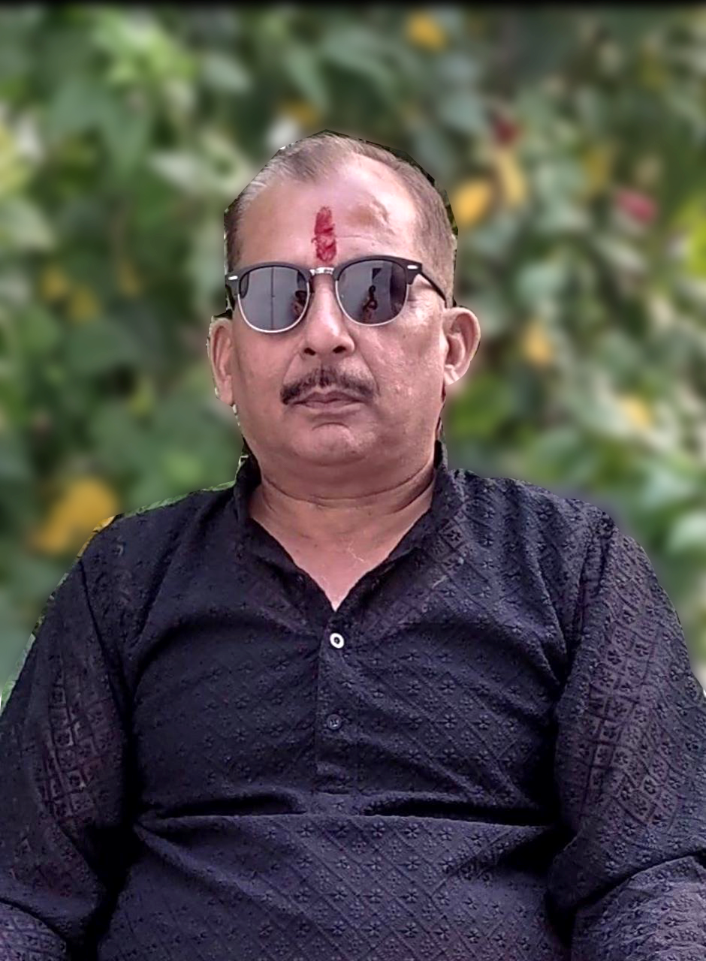
Mr. Anurag Dave
Accountant
(AGI)

Slide 13
Admission Cell`

Slide 14

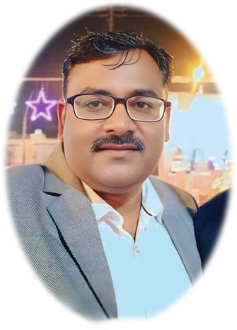
Mr. Ambrish Verma
Head marketing & Admission cell (AGI)

Slide 15

Training
And
Placement Cell`

Slide 16

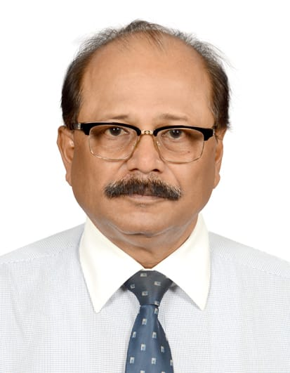
Mr. Biplab Kundu
Manager Operations and Talent Acquisition (AGI)

Slide 17

Ms. Anjali Pandey
Head T&P Cell
(AGI)

Slide 18

Academic Authorities (Pharmacy)

Slide 19

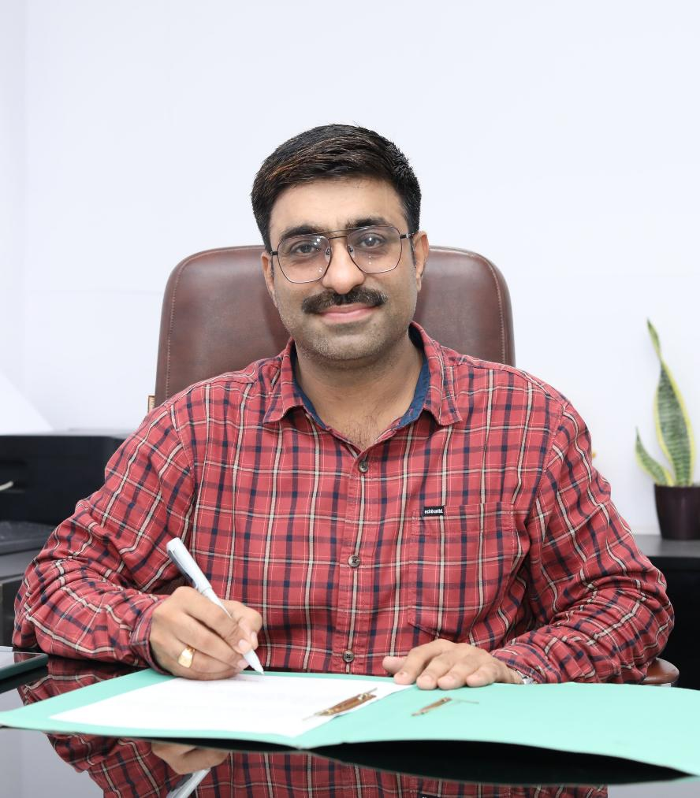
Prof. (Dr.) Dharamveer
Director (Pharmacy)

Slide 20
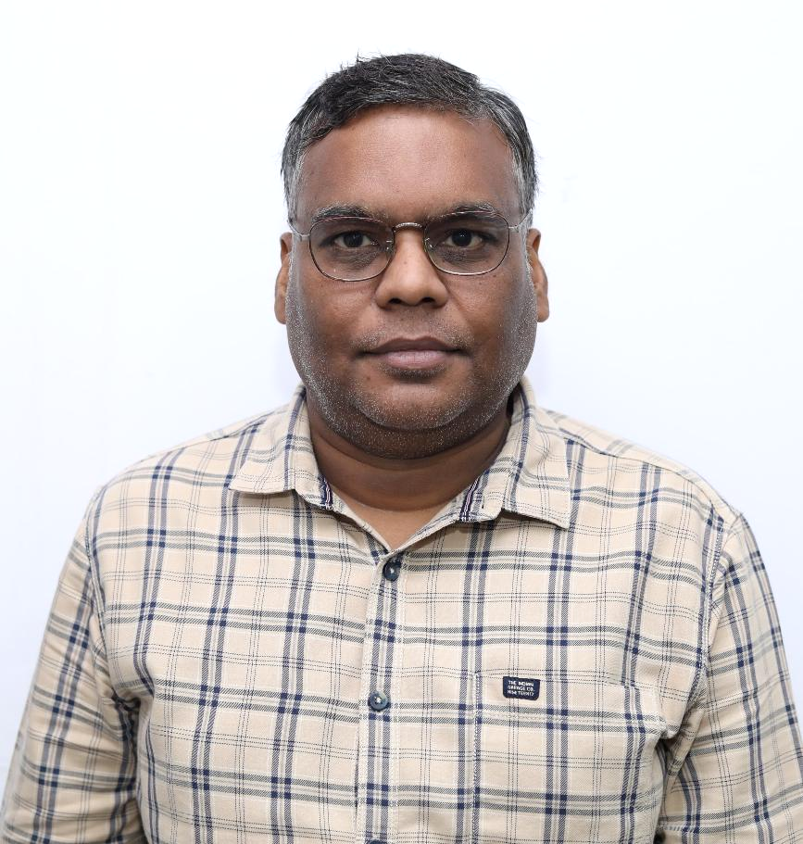
Mr. Ajay Verma
Dean Academics (Pharmacy)

Slide 21


Mr. Prashant Singh
Principal (D.Pharm.)

Slide 22
Academic Authorities (Polytechnic)

Slide 23
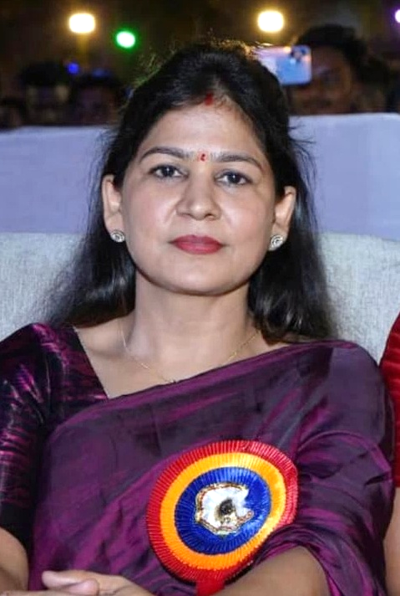
Ms. Sweeti Mishra
(Principal)

Slide 24

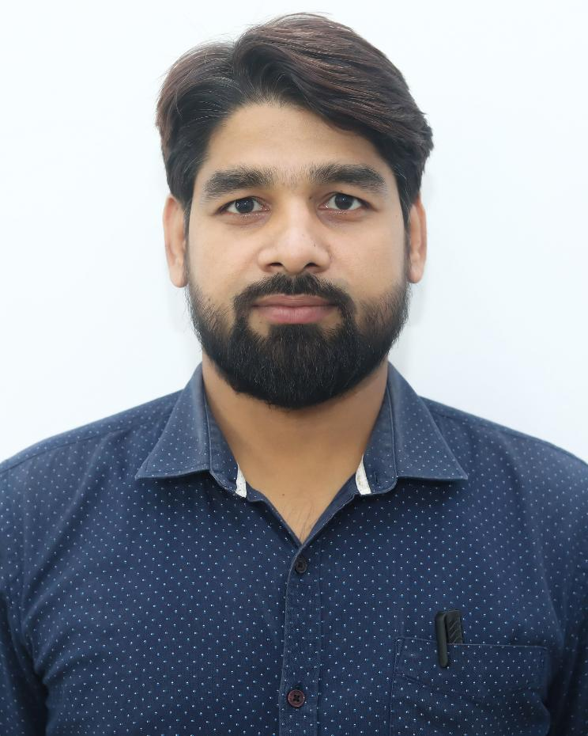
Mr. Ashish Mishra
Incharge
(Mech. Dept.)

Slide 25
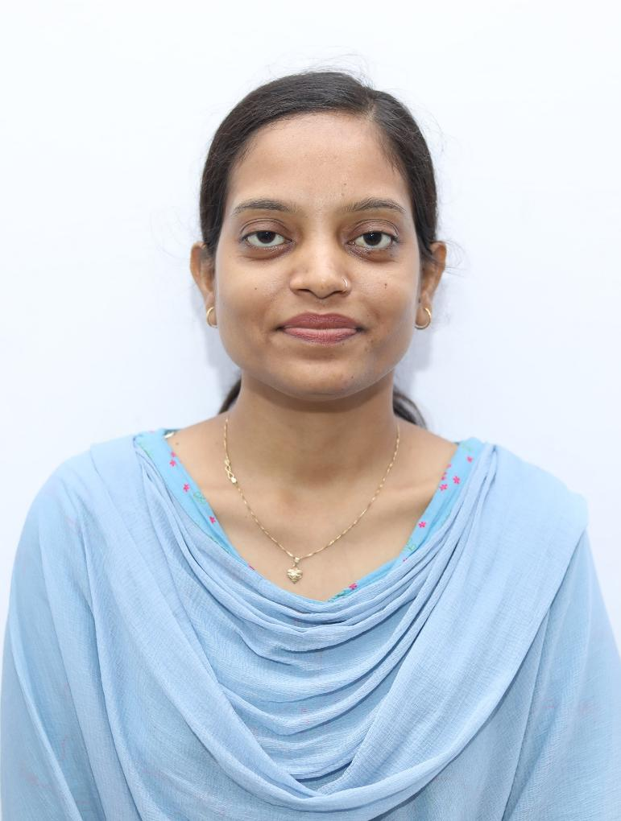
Ms. Fiza Hussain
Incharge
(Computer Science)

Slide 26
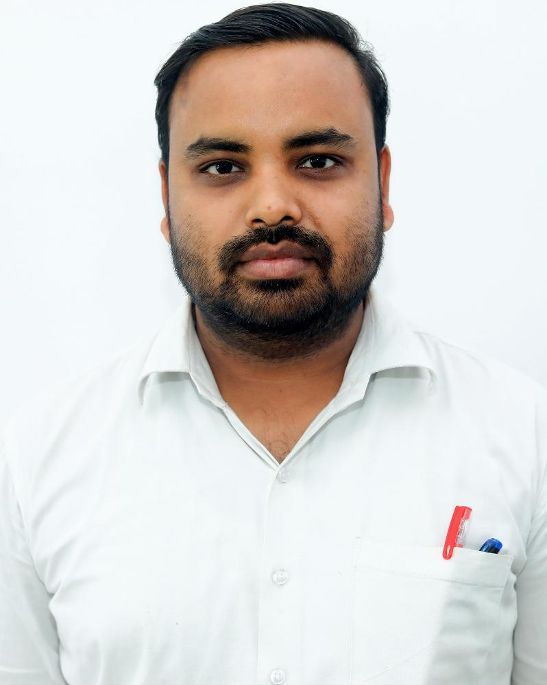
Mr. Anuj Rathor
Incharge (Civil Dept.)

Slide 27
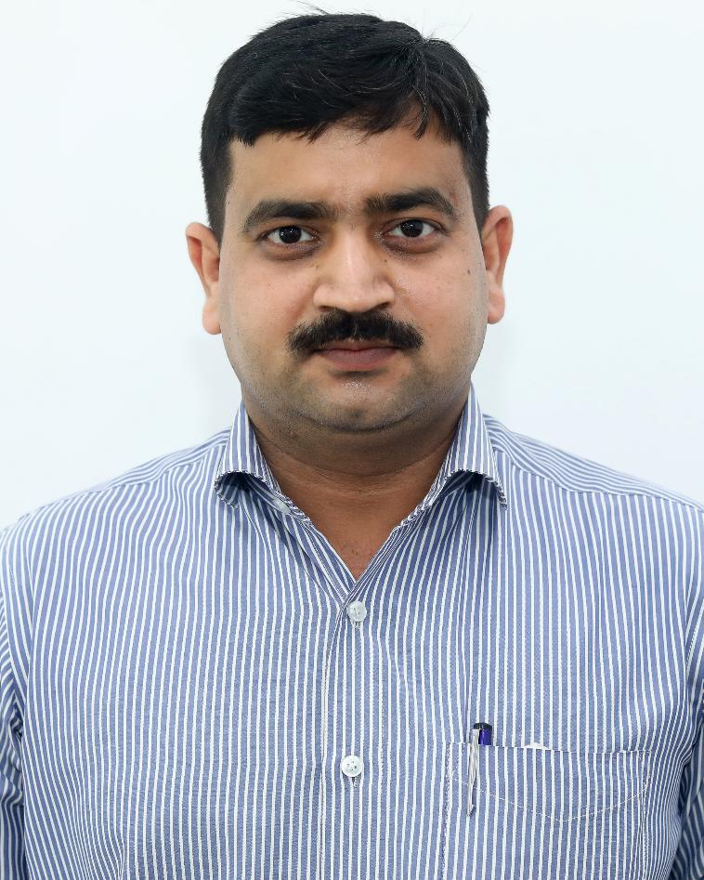
Mr. M.P. Singh
Incharge
(Electrical Dept.)

Slide 28
Freshers
Now You are also the member of AGI Family

